Slide 1


ZEROTH REVIEW
Sign Language to Audio and Text Conversion System
Student Name: [Student Name]
Guide: [Guide Name]
Register No: [Register Number]
College: [College Name]
Department: Computer Science
Year: 2025-2026

Slide 2
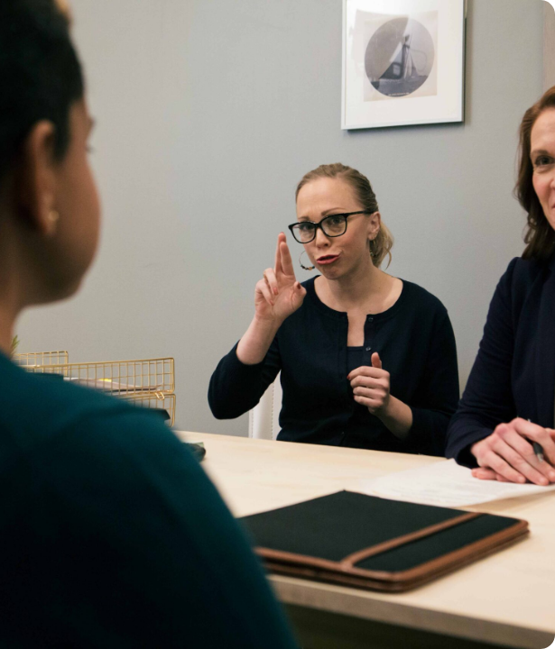
Project Outline
Problem Statement
Communication between the deaf/mute community and the general population is hindered by a lack of sign language understanding.
Proposed Solution
Real-time gesture recognition system.
Instant conversion to Text (Subtitles).
Synthesis of Audio (Speech) output.
Optional document generation for records.

Slide 3











Objectives
Recognize
Convert
Speak
Access
Detect hand gestures in real-time using camera input and Computer Vision.
Translate recognized gestures into readable text and sentence structures.
Generate synthesized voice output using Text-to-Speech engines.
Bridge the communication gap and improve social inclusion.

Slide 4


Project Domain
Primary Domain
Sub Domains
Machine Learning & Artificial Intelligence
Computer Vision: For gesture tracking.
Deep Learning: For pattern classification.
Speech Processing: For audio synthesis.

Slide 5




System Overview
Processing
Output
ML Model (CNN/LSTM) identifies hand landmarks.
Text is converted to Audio via TTS API.
Input
Translation
Camera captures live video feed of hand gestures.
Predicted gestures are mapped to text.

Slide 6


Tools & Technologies
Language: Python 3.x
Frontend: HTML, CSS, JS / Android UI
Computer Vision: OpenCV, MediaPipe
ML Libraries: TensorFlow / Keras
Speech: pyttsx3 / Google TTS API
IDE: VS Code / Android Studio

Slide 7

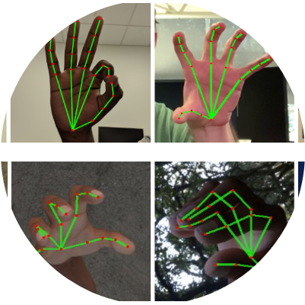
Expected Outcome
Key Deliverables
Real-time Recognition: Minimal latency in gesture detection.
High Accuracy: Precise identification of alphabets and words.
User-Friendly Interface: Simple UI for ease of use.
Social Impact: A helpful tool for the deaf and mute community.

Slide 8


Conclusion
This project aims to leverage Machine Learning and Computer Vision to create an intelligent system that improves communication, fosters social inclusion, and empowers the differently-abled community.

Slide 9
Q & A
Thank you for your attention.
[Student Email]

Slide 10




Image Sources
https://sorenson.com/wp-content/uploads/2025/01/on-site-interpreter-scaled.jpg
Source: sorenson.com
https://api.edoxi.com/assets/studyhub/ezgif_com-gif-maker_(24).webp
Source: www.edoxi.com
https://1.bp.blogspot.com/-8SxmsK5VoJ0/XVrTpMrJDFI/AAAAAAAAEiM/nAa3vuj8a2sjgEPAeMKXD4m09yKUgjVIQCLcBGAs/s1600/Screenshot%2B2019-08-19%2Bat%2B9.51.25%2BAM.png
Source: research.google
https://static.vecteezy.com/system/resources/previews/014/894/977/non_2x/abstract-technological-background-futuristic-illustration-of-high-computer-and-communication-technologies-on-a-blue-background-high-tech-digital-technology-vector.jpg
Source: www.vecteezy.com

